Slide 1
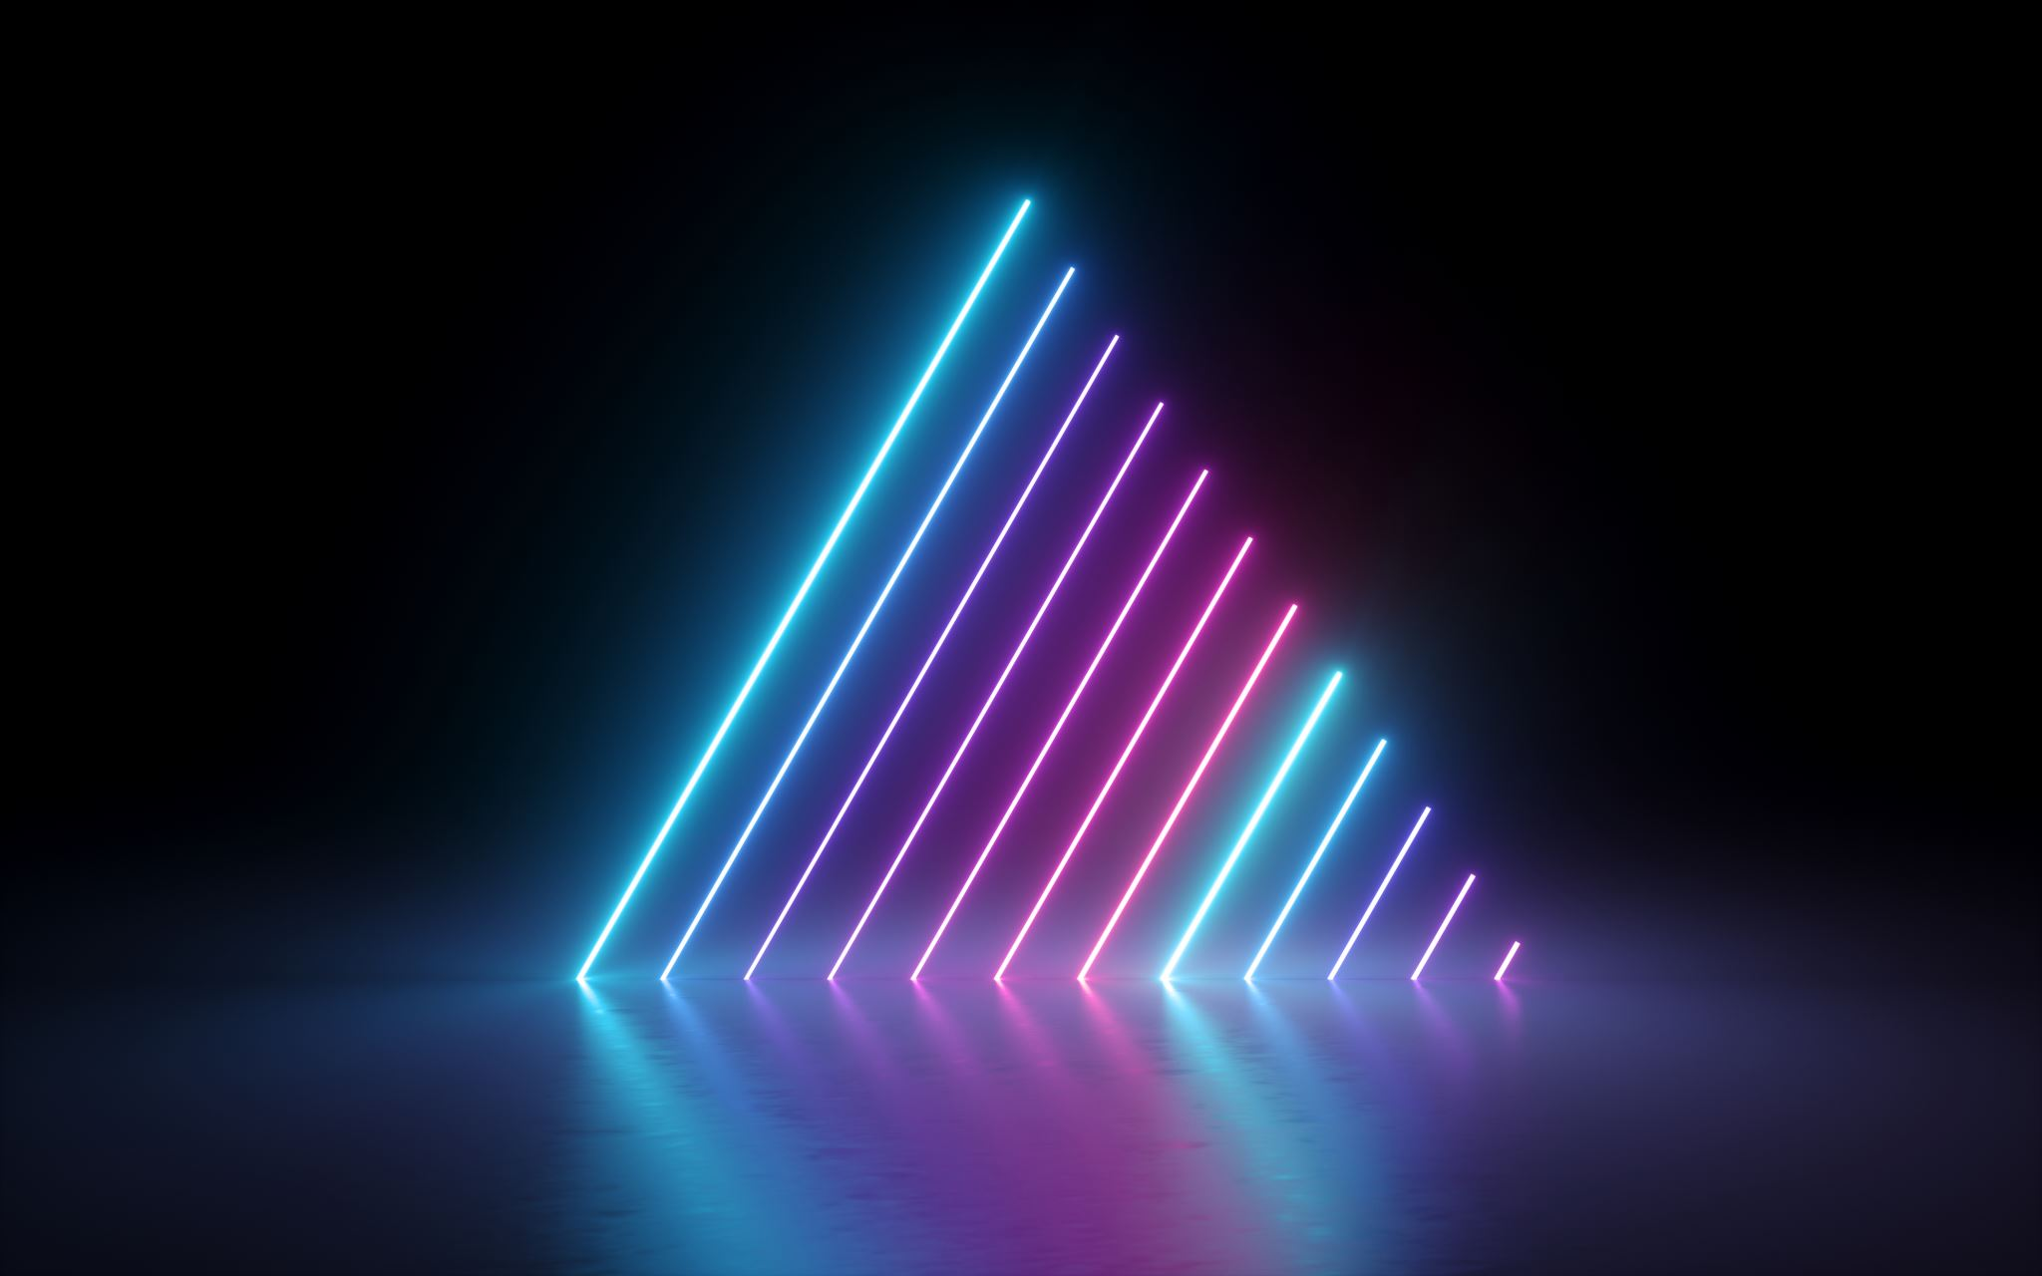

Slide 2
Secret Language of light
Presented by
Shreyas Mirashi
Karthik Maheshwaram
Harsh Maurya
Benny M
Marisa Menezes

Slide 3
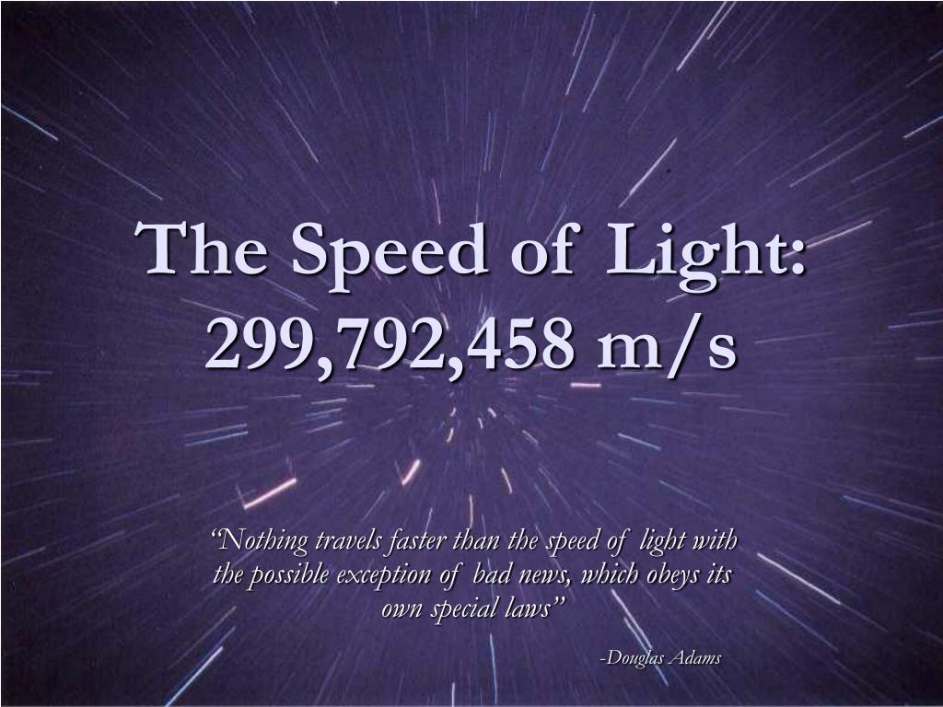
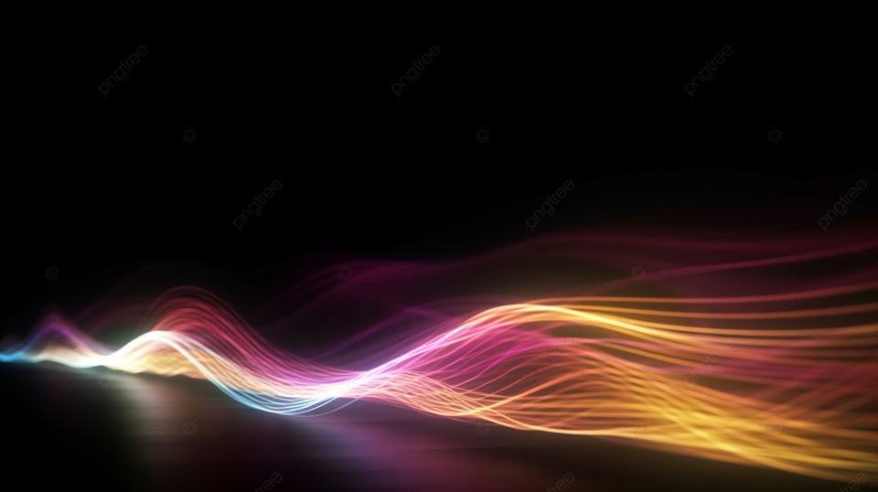
The speed of light, a fundamental constant of the universe, has fascinated scientists for centuries. An immutable constant, continues to shape our understanding of the cosmos. It is not merely a physical constant; it is a cosmic boundary that defines the very fabric of our universe.
Abstract

Slide 4
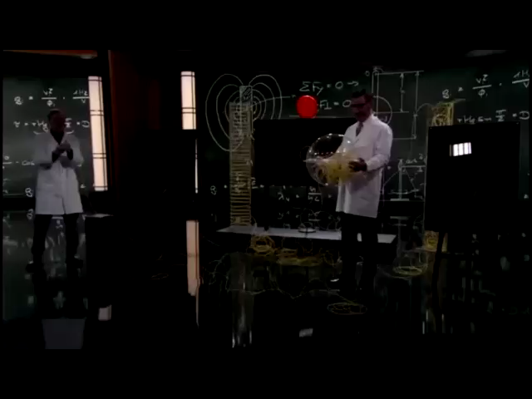

Slide 5
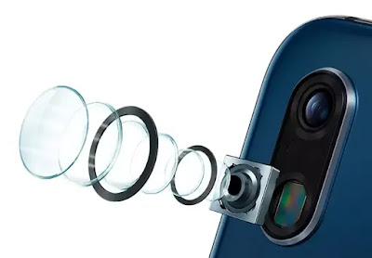
In our today’s presentation we will explore an experiment, which leverages the advanced sensor capabilities of modern smartphones to investigate spectrometer. By utilizing the camera sensor integrated into the device. Through careful calibration and data acquisition, we will analyse wavelengths of different colours.
Today’s Focus
So, Let’s Begin

Slide 6
To verify the value of speed of light by calculating wavelength and frequency through spectrometer.
Aim
We know that speed of light is 3 x 10^8 m/s, but we aim to cross examine this value through our phone camera. This experiment will not only provide a hands-on understanding of this fundamental constant but also highlight the precision and accuracy of modern measurement techniques.

Slide 7
To procced with our experiment we need the following Required Components:
Apparatus
Smartphone: A modern smartphone with a high-quality camera and access to a colour-sensing app or software.
Colour-sensing app or software: A reliable app that can accurately measure the RGB (Red, Green, Blue) values of a colour.
Light source: A monochromatic light source or a narrow-band light filter to isolate a specific colour.

Slide 8
The history of measuring the speed of light is fascinating. Initially, it was believed that light travelled instantaneously.
Theory
However, in the 17th century, Danish astronomer Ole Romer made the first quantitative estimate by observing Jupiter's moons.
He noticed variations in their eclipse timings, concluding that light has a finite speed. Later, scientists like Christiaan Huygens and James Bradley refined these measurements.
Today, the speed of light is a fundamental constant in physics, defined as exactly 299,792,458 meters per second.

Slide 9
The Nature of Light: A Wave-Particle Duality
Theory
Light: A Dual Nature.
Wave-like Behaviour: Light exhibits properties like interference and diffraction, characteristic of waves
Particle-like Behaviour: Can be explained by phenomenon like photoelectric effect
Wavelength (λ): Distance between two consecutive peaks or troughs of a wave.
Frequency (f): Number of wave cycles per second.
Speed of light (c): Constant speed at which light travels in a vacuum (approximately 3 x 10^8 m/s).

Slide 10
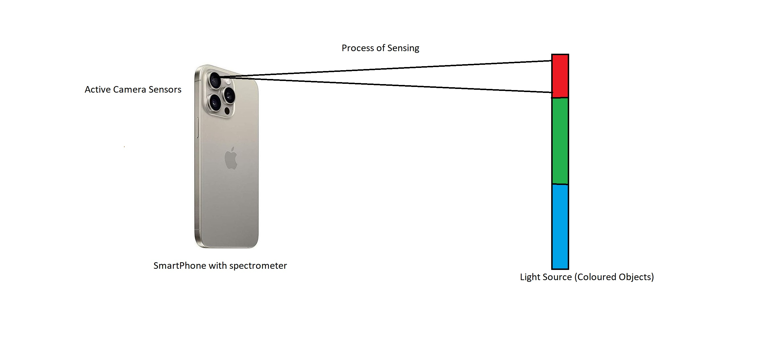
Diagram

Slide 11
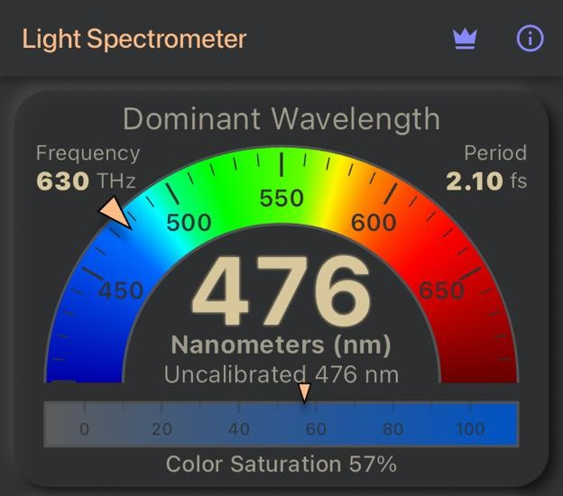
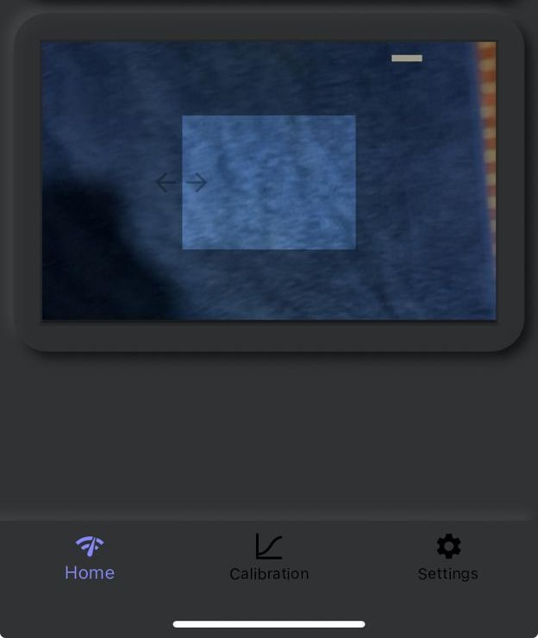
Set Up: Place the phone on a flat stable surface. Position the light source (coloured objects) so it shines directly on the camera. Open the App: Launch the spectrometer app on your phone. Ensure the app has permission to access your camera.
Procedure

Slide 12
Capture the Spectrum: Point your phone's camera at the coloured objects. The app will display a spectrum of colours, representing the different wavelengths of light emitted by the source. Read the Wavelength and frequency: The app will display the wavelength value (in nanometres) and frequency value in Terahertz (THz). Calculate speed of light by using the formula.
Procedure
Repeat all the above steps for different colours
Plot the graph of wavelength and 1/frequency, the slope will give us speed of light.

Slide 13
Speed of light often denoted by the letter “c”, is a fundamental constant. In terms of frequency (f) and wavelength (λ) it is expressed as c = fλ To verify the results, we plot a graph of frequency and 1/λ.
Formula

Slide 14
The experiment aims to experimentally verify the consistency of the speed of light. By measuring the frequency and wavelength and calculating speed of light, we anticipate obtaining consistent results.
Expected Outcome
1) The theoretical value of speed of light (c) should match with universal accepted value of c, with minimum percentage error.
2) The graph of frequency and 1/λ should give the slope value equal to our theoretical value of speed of light.

Slide 15
In conclusion, this experiment aimed to experimentally determine the speed of light using a phone camera spectrometer. By analyzing the colour produced by a light source, we were able to calculate the wavelength and frequency of the light. Subsequently, using the known relationship between wavelength and frequency, we determined the speed of light. While the experimental setup and data analysis were relatively straightforward, the accuracy of the results was influenced by factors such as the resolution of the camera, and potential environmental factors. This experiment serves as a valuable introduction to the principles of optics and spectroscopy, demonstrating the power of simple experimental techniques to explore fundamental physical constants.
Conclusion

Slide 16
References
Google Gemini
2) The Secret language of Light: associated with a set of oracle deck created by Denise Jarvie
3) Wikipedia
4) Dominant λ Light Spectrometer app developed by Contechity.
5) https://youtu.be/pTn6Ewhb27k?si=I1O2-g_z67lhKvHw

Slide 17
Thank You

Slide 18
Contributions
Idea and logic: Harsh, Shreyas.
PPT and text editing: Karthik.
Image and video Source: Marisa.
Video Editing: Benny.
Presented by C1 Batch Group 4.

Slide 19
